Slide 1
Biomass-Flux Working Group
as listed on Website
Participant Name Organization
Collatz, George (Jim) (WG Lead) NASA GSFC
Brown, Molly NASA GSFC
Denning, Scott Colorado State University
Escobar, Vanessa Sigma Space Corp.
French, Nancy Michigan Tech Research Institute (MTRI)
Houghton, Richard (Skee) The Woods Hole Research Center
Hurtt, George University of Maryland
Kang, Christine UMD
McKenzie, Donald (Don) USDA Forest Service
Schaaf, Crystal University of Massachusetts Boston
Schwalm, Christopher Northern Arizona University
Vargas, Rodrigo University of Delaware
West, Tristram (Tris) White House Council on Environmental Quality
Woo, Seung Hyun (Lucia) NASA GSFC / Sigma Space
Woodall, Christopher (Chris) USDA Forest Service
Notes:
history of group
this is my own perspective with little or no input: Hope WG members will help refine, scope working group activities

Slide 2
Biomass-Flux Working Group
Original draft with my edits
The Biomass-Flux working group seeks to integrate land-atmosphere carbon fluxes, biomass,
and changes in biomass across CMS to improve estimation of all three. The working group
will:
(1) query and identify domains in space and time for which various relevant projects
overlap;
(2) identify and encourage projects to cross-compare flux and biomass products
(3) track and summarize results and outcomes of comparisons.
The ultimate goal would be to reconcile measurements of biomass and biomass change
with process model biomass/fluxes and atmospheric CO2 variability across NASA CMS projects
working group topic seems to be a specific, detailed subset within the scopes of the algorithm assessment/intercomparison, system framework, MRV, and atmospheric validation working groups
Notes:
Not considering other carbon/biogenic species (CH4,CO, etc) though could be connected in the case of biomass burning
Land-ocean carbon fluxes because live biomass is not a big component, if we expanded the scope it could include detrital and inorganic carbon pools

Slide 3
Biomass-Flux Working Group
Relevant CMS Themes
CMS Biomass: monitor, manage biomass for greenhouse gas emissions
Products:
Static Biomass estimates at local to global scales
CMS Flux: monitor and diagnose greenhouse gas variability
Products:
-Δ Biomass, component fluxes (fire, deforestation, harvest)
-bottom up process models (diagnostic and dynamic)
-atmospheric inversions and data assimilation estimates of sources and sinks
derived from atmospheric measurements
-relationship between above ground biomass change and atmospheric CO₂ (end-to-end)
-how do biomass measurements constrain flux estimations?
-how do flux estimations constrain biomass measurements?
Notes:
not including CH4 fluxes, land to ocean fluxes, focused on measurements of agbm using remote sensing.
we have biomass measurements and CO2 measurements

Slide 4
ATMOSHERIC CO₂*
Not Local
Fire*
NPP*
RH
O
BM*
Removals
Products
Mortality*
Detritus
ΔC_{atm} =- NPP*+ RH + Fire* + Prodout (Flux focus)
ΔC_{BM} = NPP*– Fire* – Mort* - Removals* (Biomass focus)
At steady state:
ΔC_{BM} = - ΔC_{atm}
But not over shorter periods of time and locally, also true for component fluxes
*potentially informed from Remote Sensing Data
Notes:
simplified diagram of how models connect fluxes and pools
measure dagbm only part of npp allocation
dbm ne dco2 outside of steady state, dbm perturbs other pools and their fluxes
component flux estimates ne dco2, models can integrate dbm into dco2

Slide 5
Dynamics of Biomass and Flux
Neutral over decades to centuries
+
Harvest & Fire
Mortality
-
AGE (decades to centuries)
Biomass
Harvest (remove and emitted elsewhere later)
Fire (emitted locally and immediately) +mortality (emitted slowly)
Net Flux
Long term atmospheric CO2 sinks
Afforestation
Growth Enhancement
long term atmospheric CO2 source
Deforestation, Degradation

Slide 6
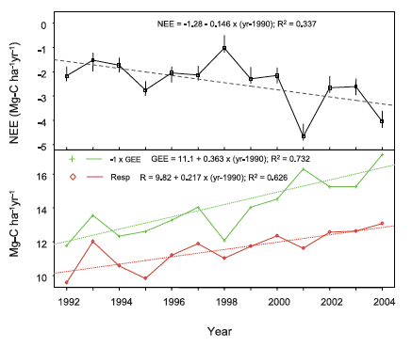
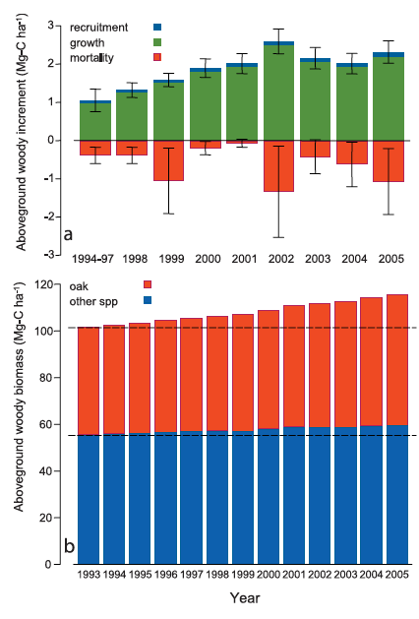
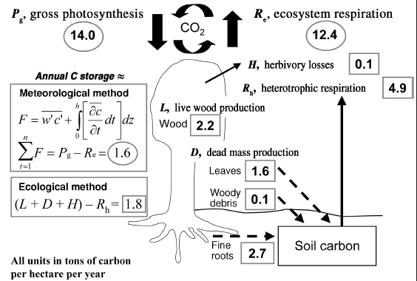
Relationship between Biomass change and Net Flux at local scales
HF, Urbanski et al., 2007
Net Flux sink= 2.5 MgC/ha/yr
Δ AGB = 1.3 MgC/ha/yr
UMBS, Gough et al., 2008
Net Flux sink = 1.6 MgC/ha/yr
Δ AGB = 2.2MgC/ha/yr
Notes:
Univ Michigan Biological Station
to estimate flux from changes in biomass requires modeling of process that are not measured directly

Slide 7
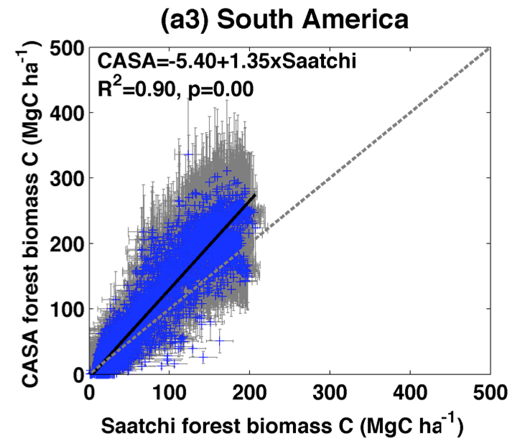
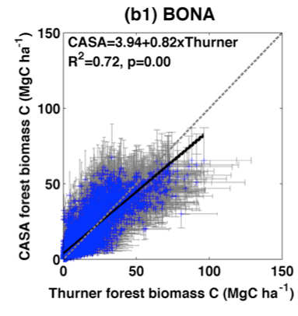
EXAMPLE of using biomass measurements to constrain flux models:
Static Biomass estimates to constrain flux models:
Biomass is a function of NPP, allocation, mortality, harvest, fuel loads.
A weak constraint on modeled fluxes

Slide 8
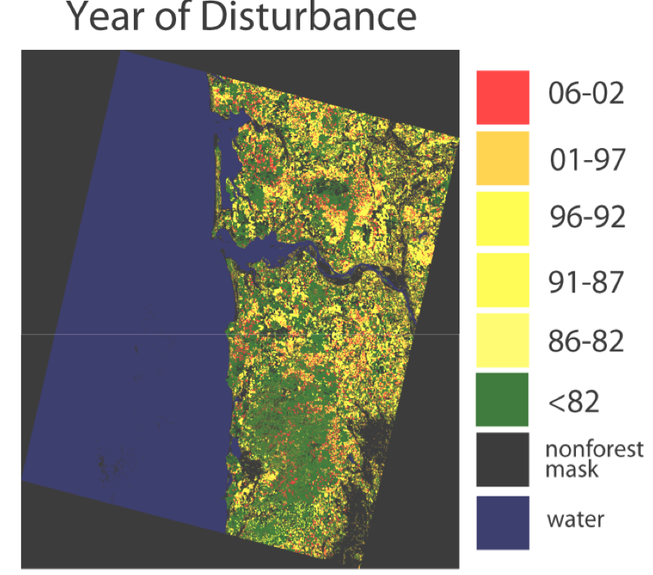
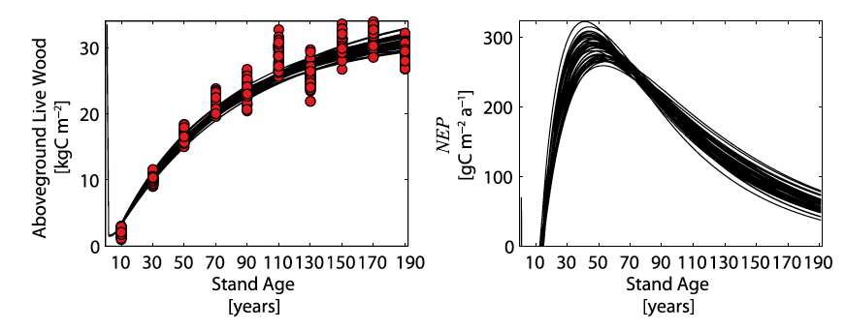
Landsat VCT
Another EXAMPLE:
Static Biomass + disturbance history to
Parameterize flux models
Williams et al., 2012, 2014

Slide 9
Strategy for linking Biomass products with Flux Products
Working Group membership should include projects willing to contribute products that
are useful for reconciling BM, fluxes, and atmospheric CO2 variability.
Group would define products at useful resolutions, formats and establish working collaborations
Issues to be resolved:
Problem of scale: at what spatial resolutions can biomass change estimates be related to
atmospheric CO2 variability?
How to verify/validate modeled fluxes
indirect model testing to support confidence in model predictions (local to global)
direct measurement of fluxes (eddy covariance, tall towers for regional fluxes)
net flux estimations using atmospheric CO2 observations and transport models
(regional to global)
Should scope be expanded to consider CH4, other biomass and detrital pools?
NOTE OVERLAP with other Working Groups:
Algorithm Assessment/Intercomparisons
System Framework
Atmospheric Validation
MRV
Notes:
this is my own perspective with little or no input: Hope WG members will help refine, scope working group activities

